Slide 2
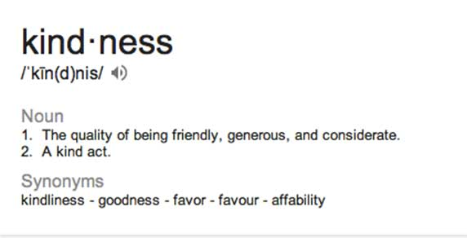

Slide 3
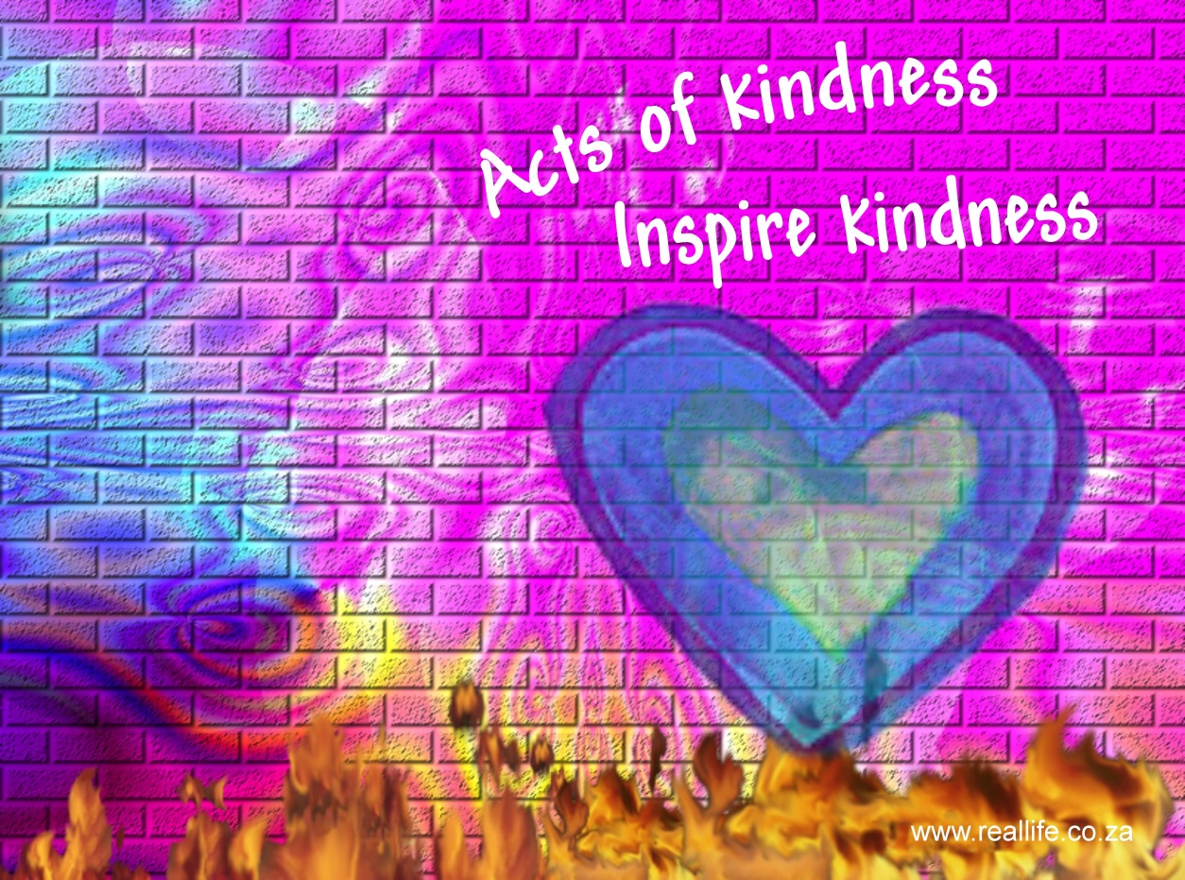
Videos

Slide 4
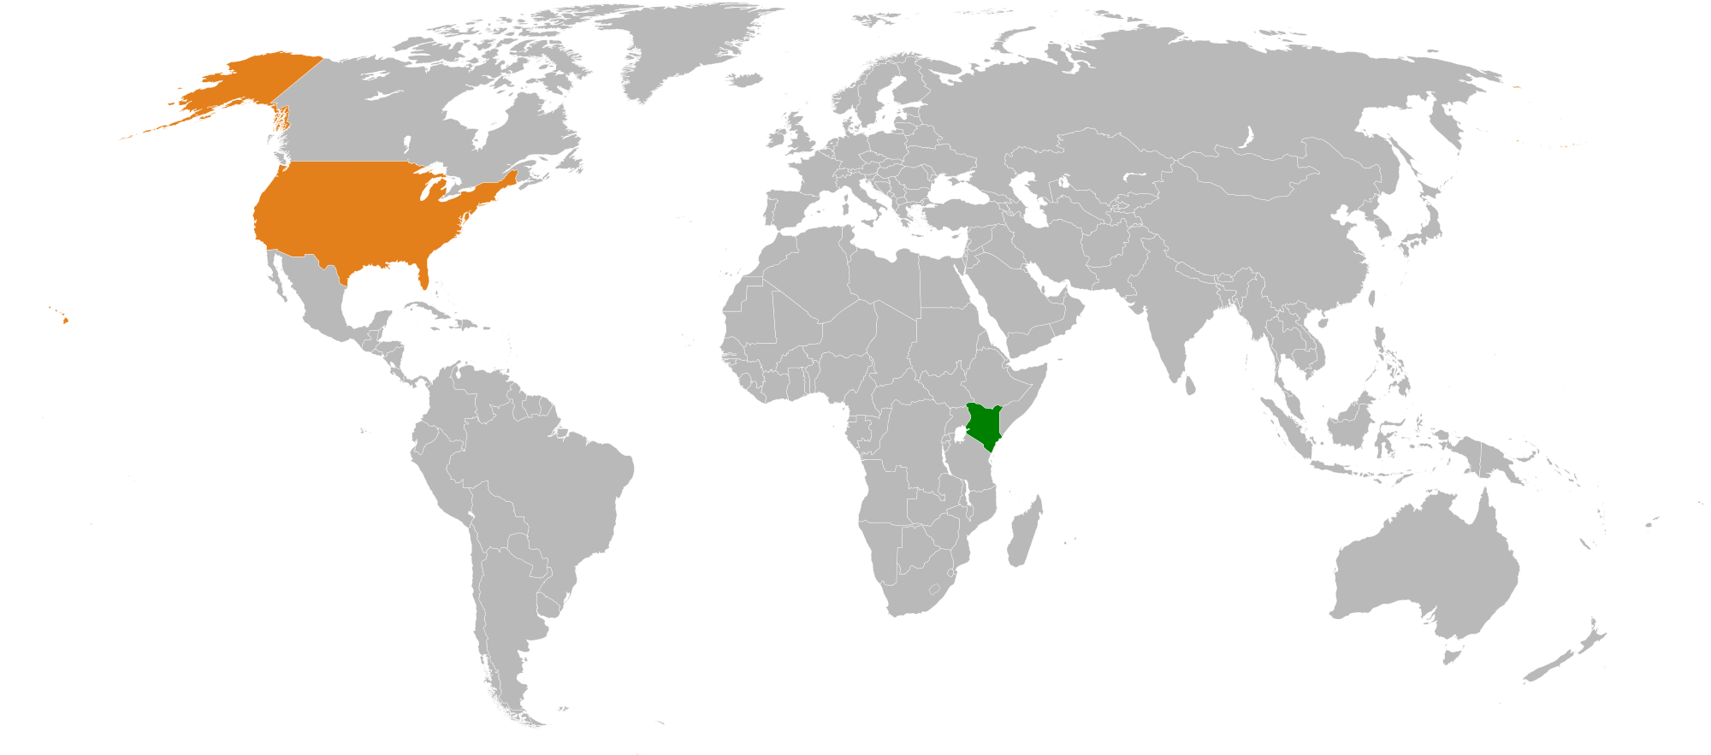
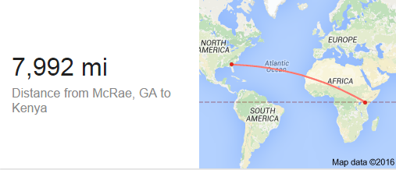
Like going to Eastman and back 200 times!

Slide 5
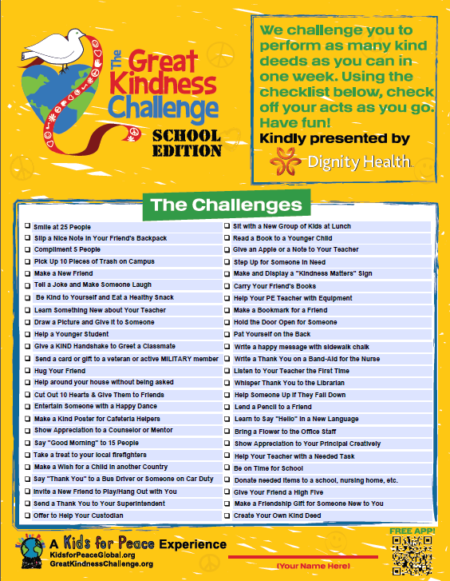
Activities
Daily Videos & Quotes
Kind Coins for Kenya Drive
Class Lessons
The Great Kindness Challenge Checklist

Slide 6
Activities
Essay Contest-Describe a person in your life who you believe demonstrates what kindness is all about.
Poster Entries
Pictures will be mailed to Kids for Peace. Your picture may be selected to be published in the 4th edition of Kindness Matters: 50 Ways to Create a Kinder World
See Mrs. Rogers or Mrs. Lovvorn for more details.
Entries due by February 11, 2016.

